Slide 1
Advanced Kaggle
Moving on to advanced level

Slide 2
Index
About Me | 3-9
My mentors | 10-11
Kaggle | 12-15
Resources | 16

Slide 3
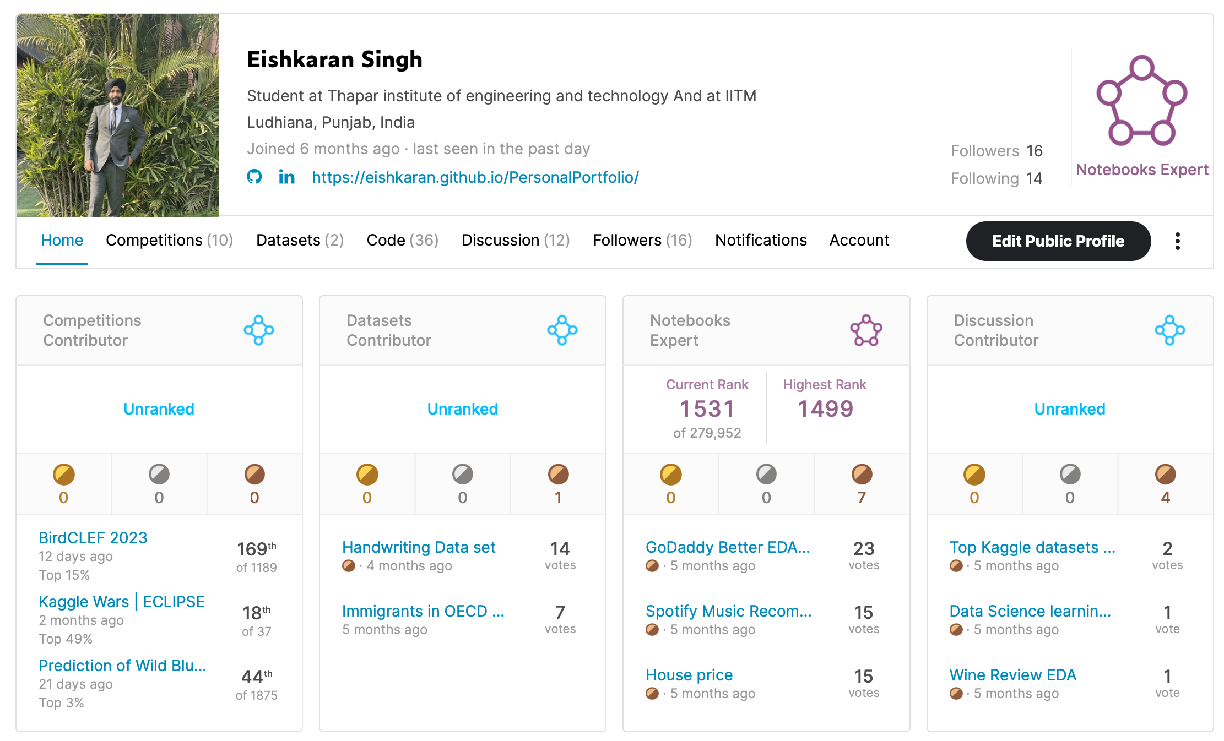
About Me
Aim:- Data analyst/ Data Scientist
I am Eishkaran Singh, a second year COE TIET and pursuing my BS from Indian Institute of Technology Madras
My skills:
MATHEMATICS (Linear algebra, Statistics and probability, Calculus )
PROGRAMMING LANGUAGES (Python(advanced) , C, C++)
WEB DEVELOPMENT (HTML, CSS, JAVASCRIPT)
LIBRARIES/FRAMEWORK (Pandas, Numpy, Seaborn, matploblib, Plotly, XGBoost, scikit-learn)
MACHINE LEARNING (Regression, Classification, Clustering, Neural Networks, Deep Learning)
DATABASE MANAGEMENT SYSTEMS (MySQL,Oracle)
Linkedin Profile :- https://www.linkedin.com/in/eishkaran-singh/
Website Portfolio:- https://eishkaran.github.io/PersonalPortfolio/index.html
Kaggle Profile :- https://www.kaggle.com/eishkaran
Github Profile:- https://github.com/EISHKARAN

Slide 4
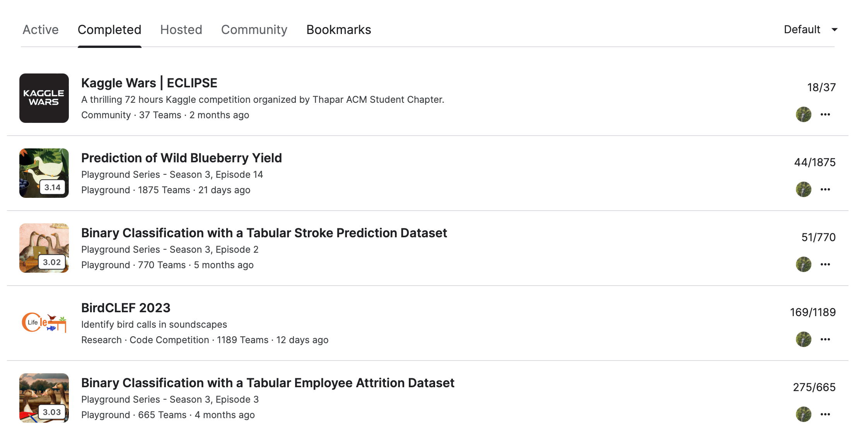
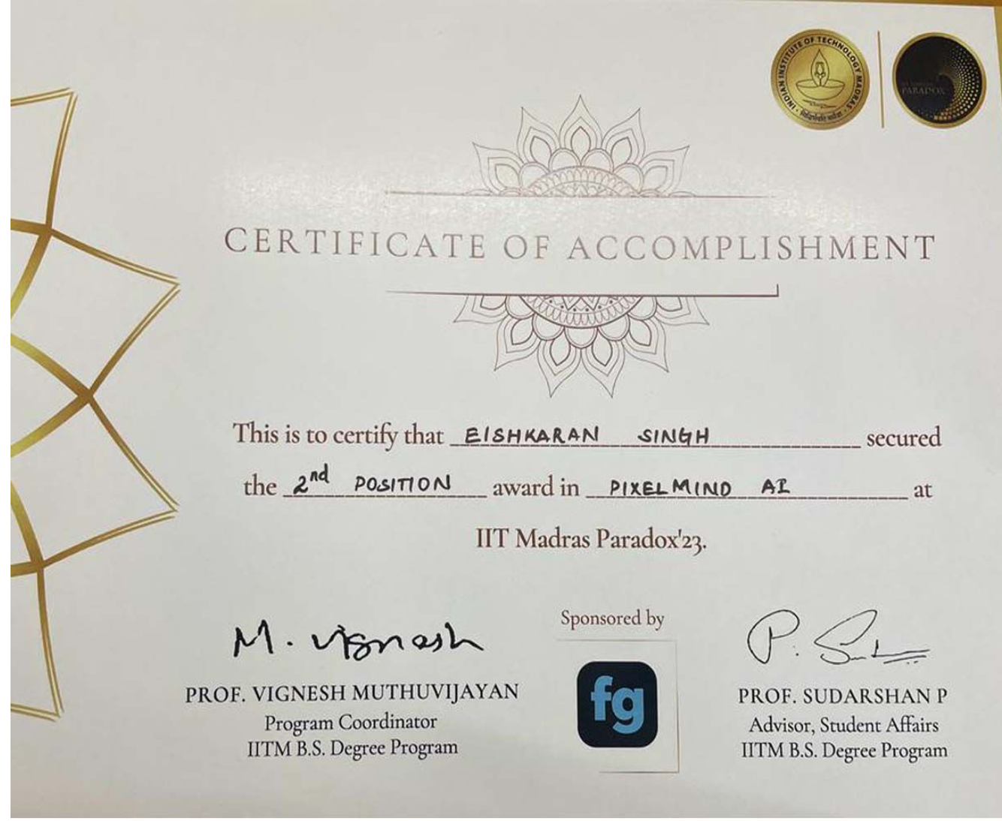
About Me
Achievements:
I recently participated in Paradox’23 organized by IITM and took part in Pixelmind AI
won the second prize and bagged a cash prize of 50K
I have shown exceptional skills in data sciences because of which I am at 2x expert level in Kaggle which is one of the leading platforms for Data Sciences
I have participated in various competitions organized at the Kaggle platform and have shown outstanding results

Slide 5
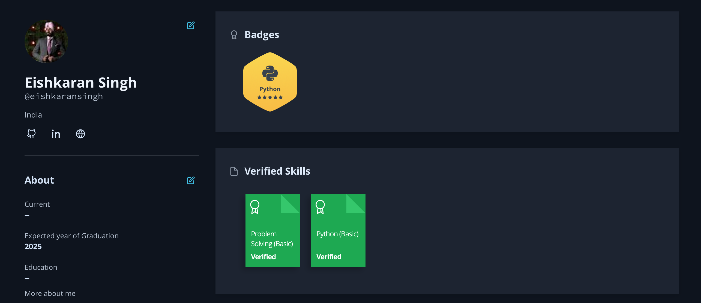
About Me
Courses I did and where did I get there certification
Python:-
Learnt From Code with Harry, Kaggle
IITM resources
Gained fluency by solving problems on Hackerank, Self-Practice (Problems )

Slide 6
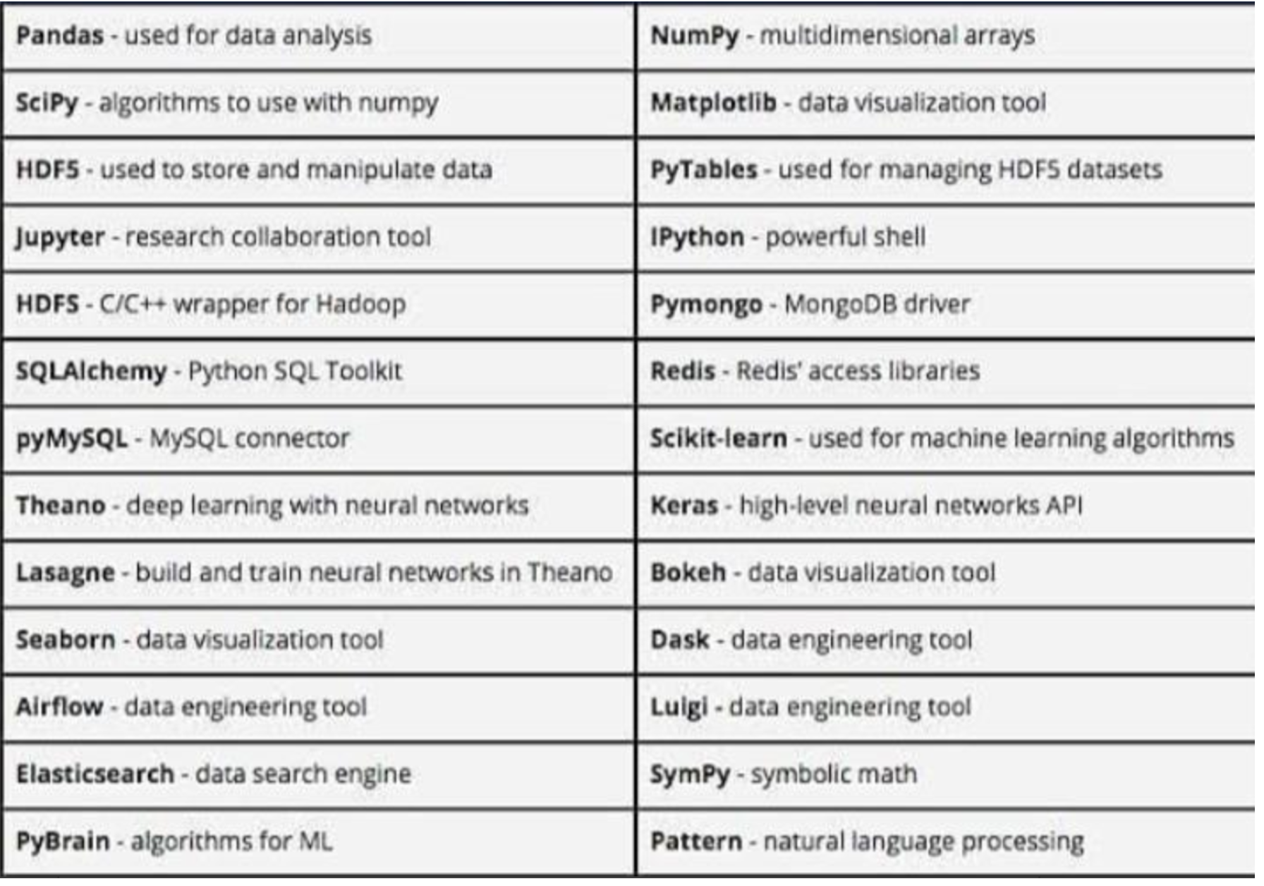
Python Tools

Slide 7
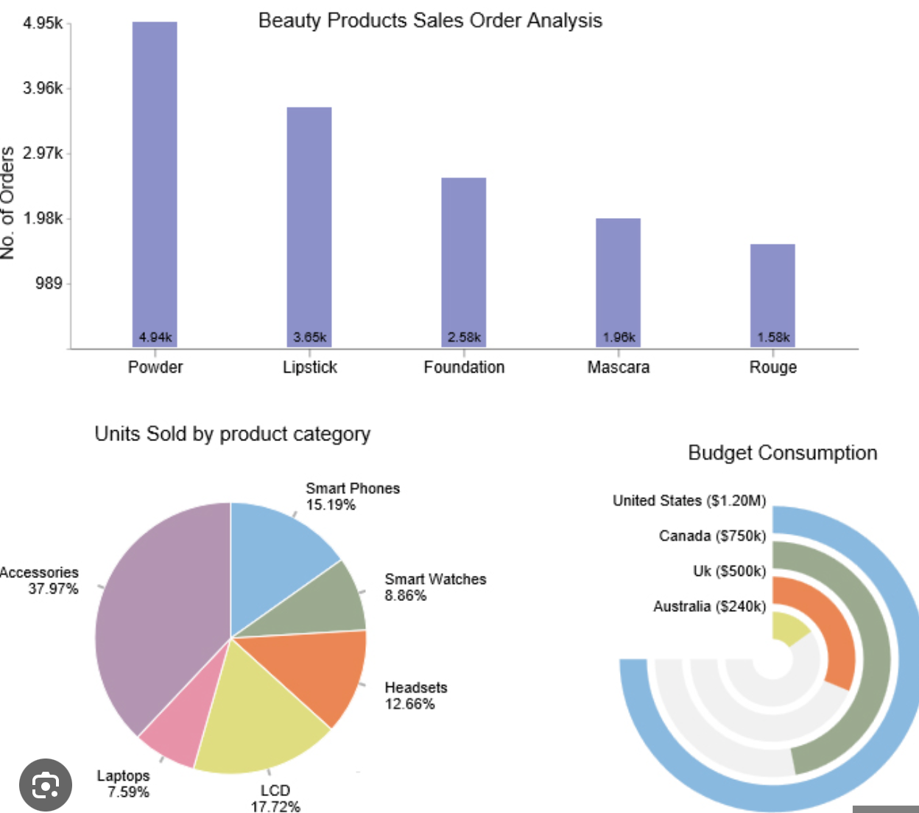
About Me
Courses I did and where did I get there certification
Data Visualization
I learnt the libraries for data Visualization by reading the documentation of the library and understanding its function {Documentations can be found on google by searching them }
I learnt the visualizations by going through numerous Kaggle Notebooks and even discussions
But the major thing that can help u gain efficiency is that ”PRACTICE”
Some notebooks that will help you understand the things Types of visualisations, Sample Notebook 1, Sample Notebook 2, Sample Notebook 3

Slide 8
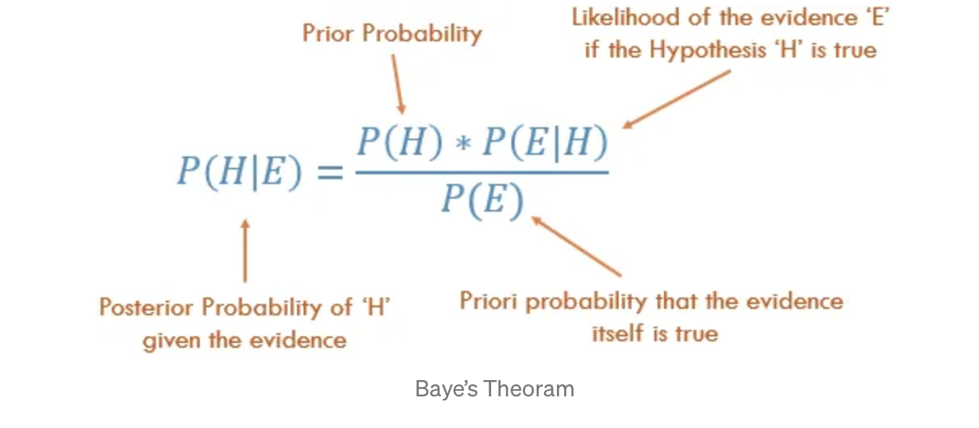
About Me
Courses I did and where did I get there certification
Statistics
It is one of the most important things that a person should know before going in for data analysis
I learnt the same from IITM resources (majorly} and Youtube Videos

Slide 9
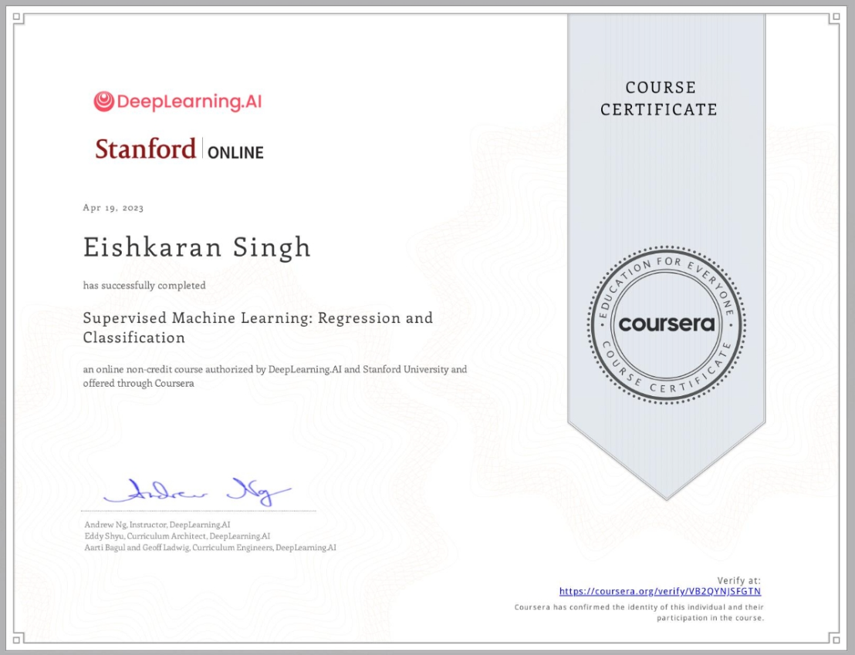
About Me
Courses I did and where did I get there certification
Machine Learning
It is one of the most important things that a person should know before going in for data Prediction
I learnt the same from studying various medium blogs and from coursera with the course name of Machine learning for all by Andrew Ng

Slide 10
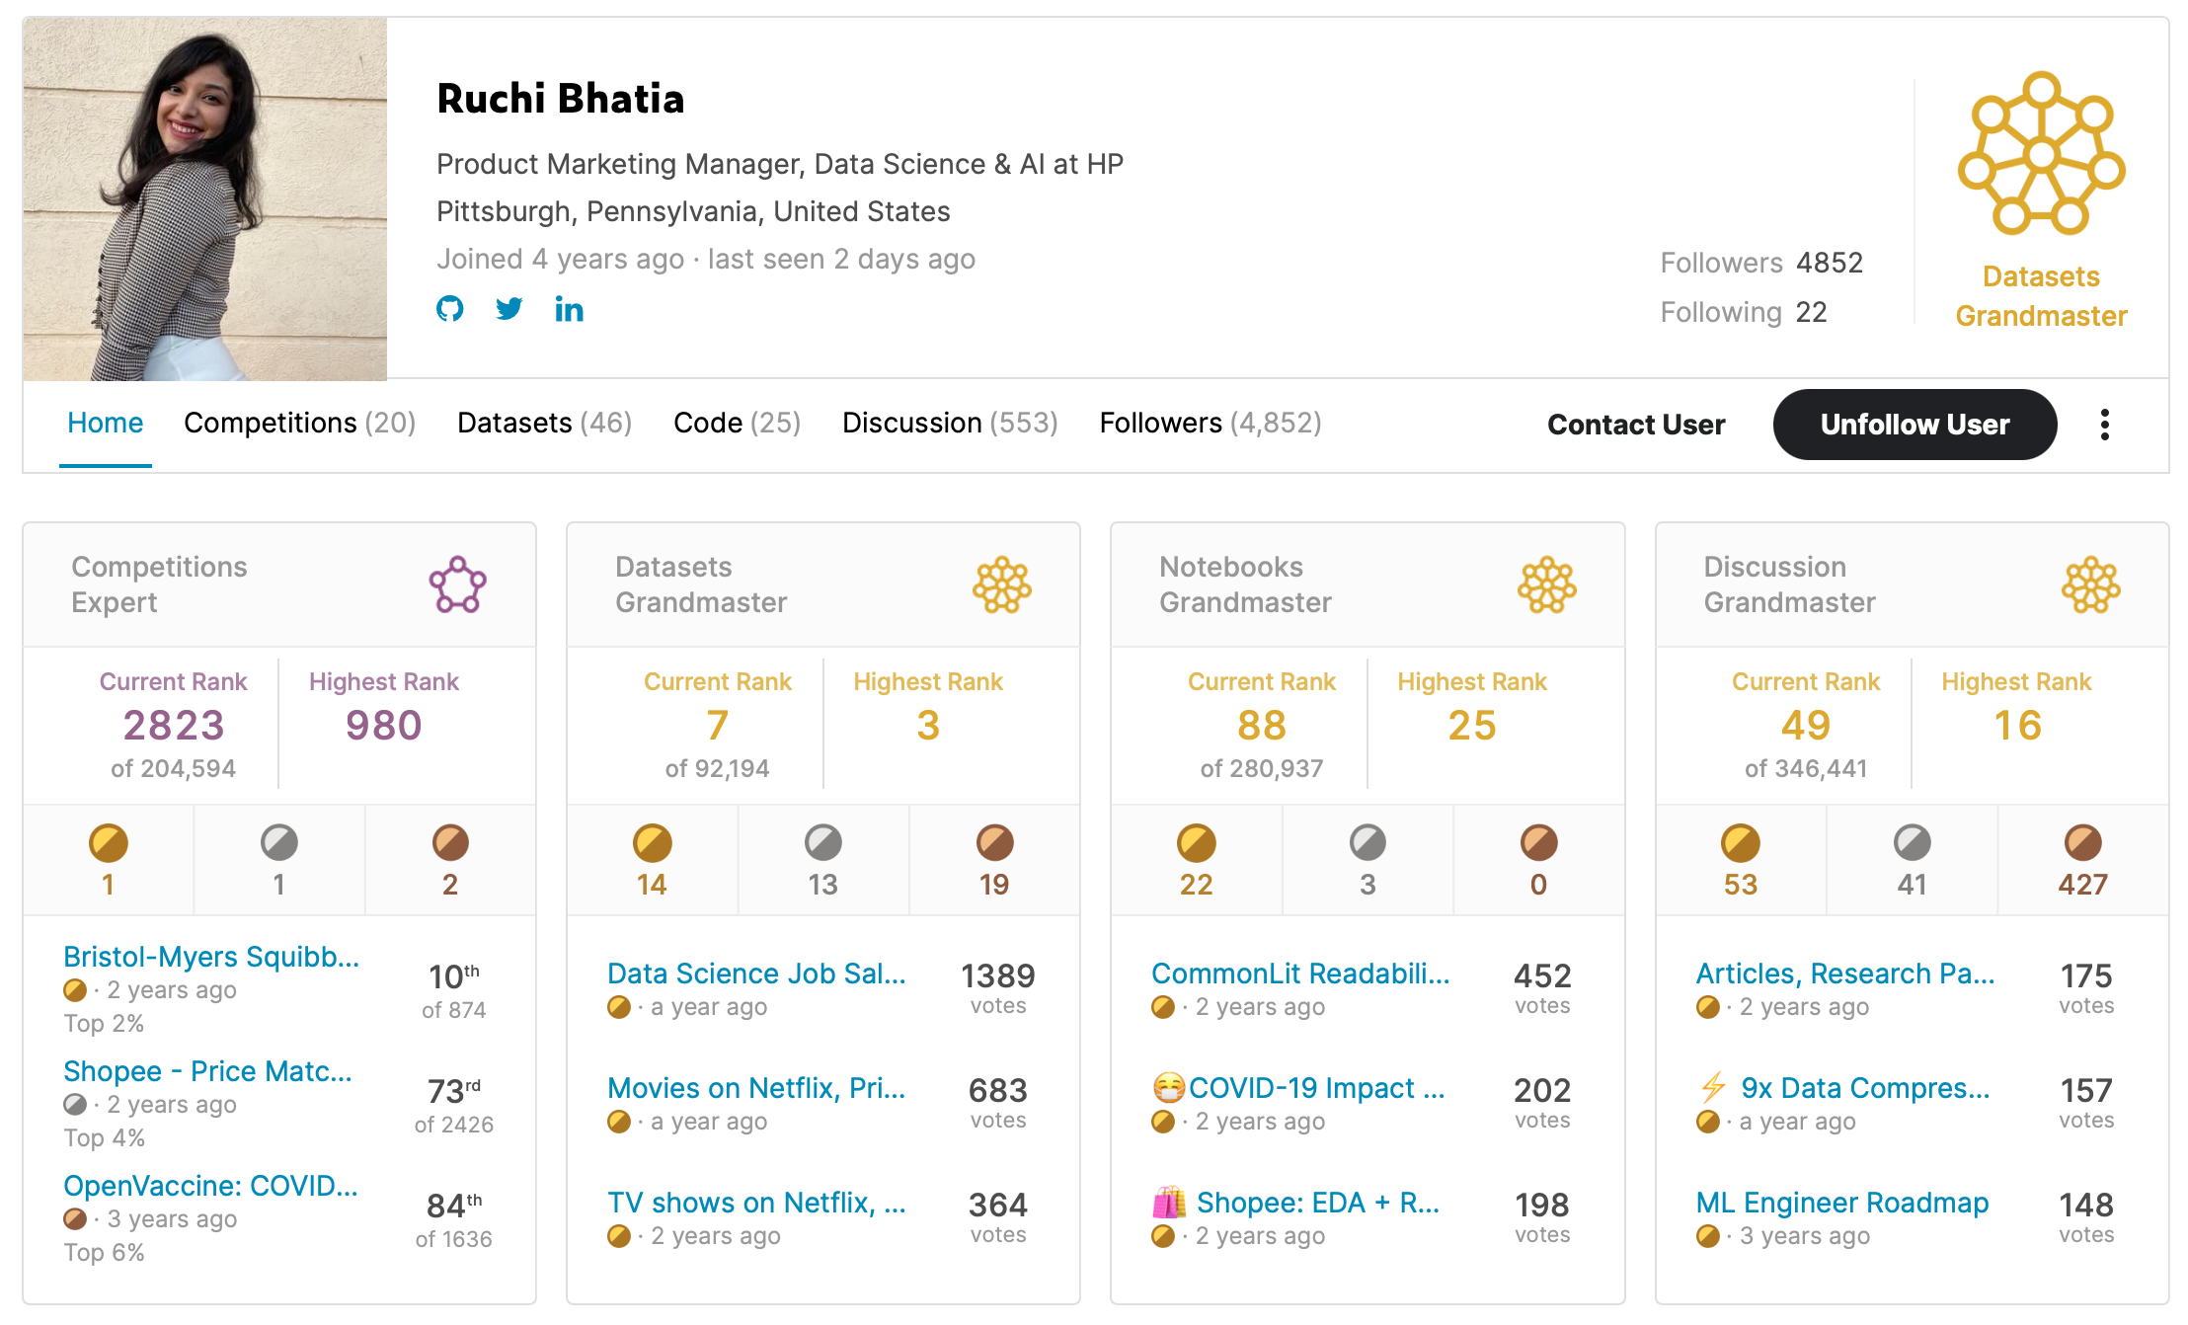
My Mentors
Ruchi Bhatia
She is a Computer Engineering graduate and currently only the 6th Grandmaster in the Datasets tier on Kaggle
She did her master's degree in Information Systems Management from Carnegie Mellon University.
She currently is one of the 21 Data Science Ambassadors for Z by HP
Portfolio Website , Kaggle Profile
Skills :-
Programming Languages: C, C++, Java, Python, SQL
Web: HTML, CSS3, JavaScript, jQuery, Bootstrap, PHP, Express, Angular, Node.js
Analytics and ML: NumPy, Pandas, TensorFlow, Scikit-learn, Keras

Slide 11
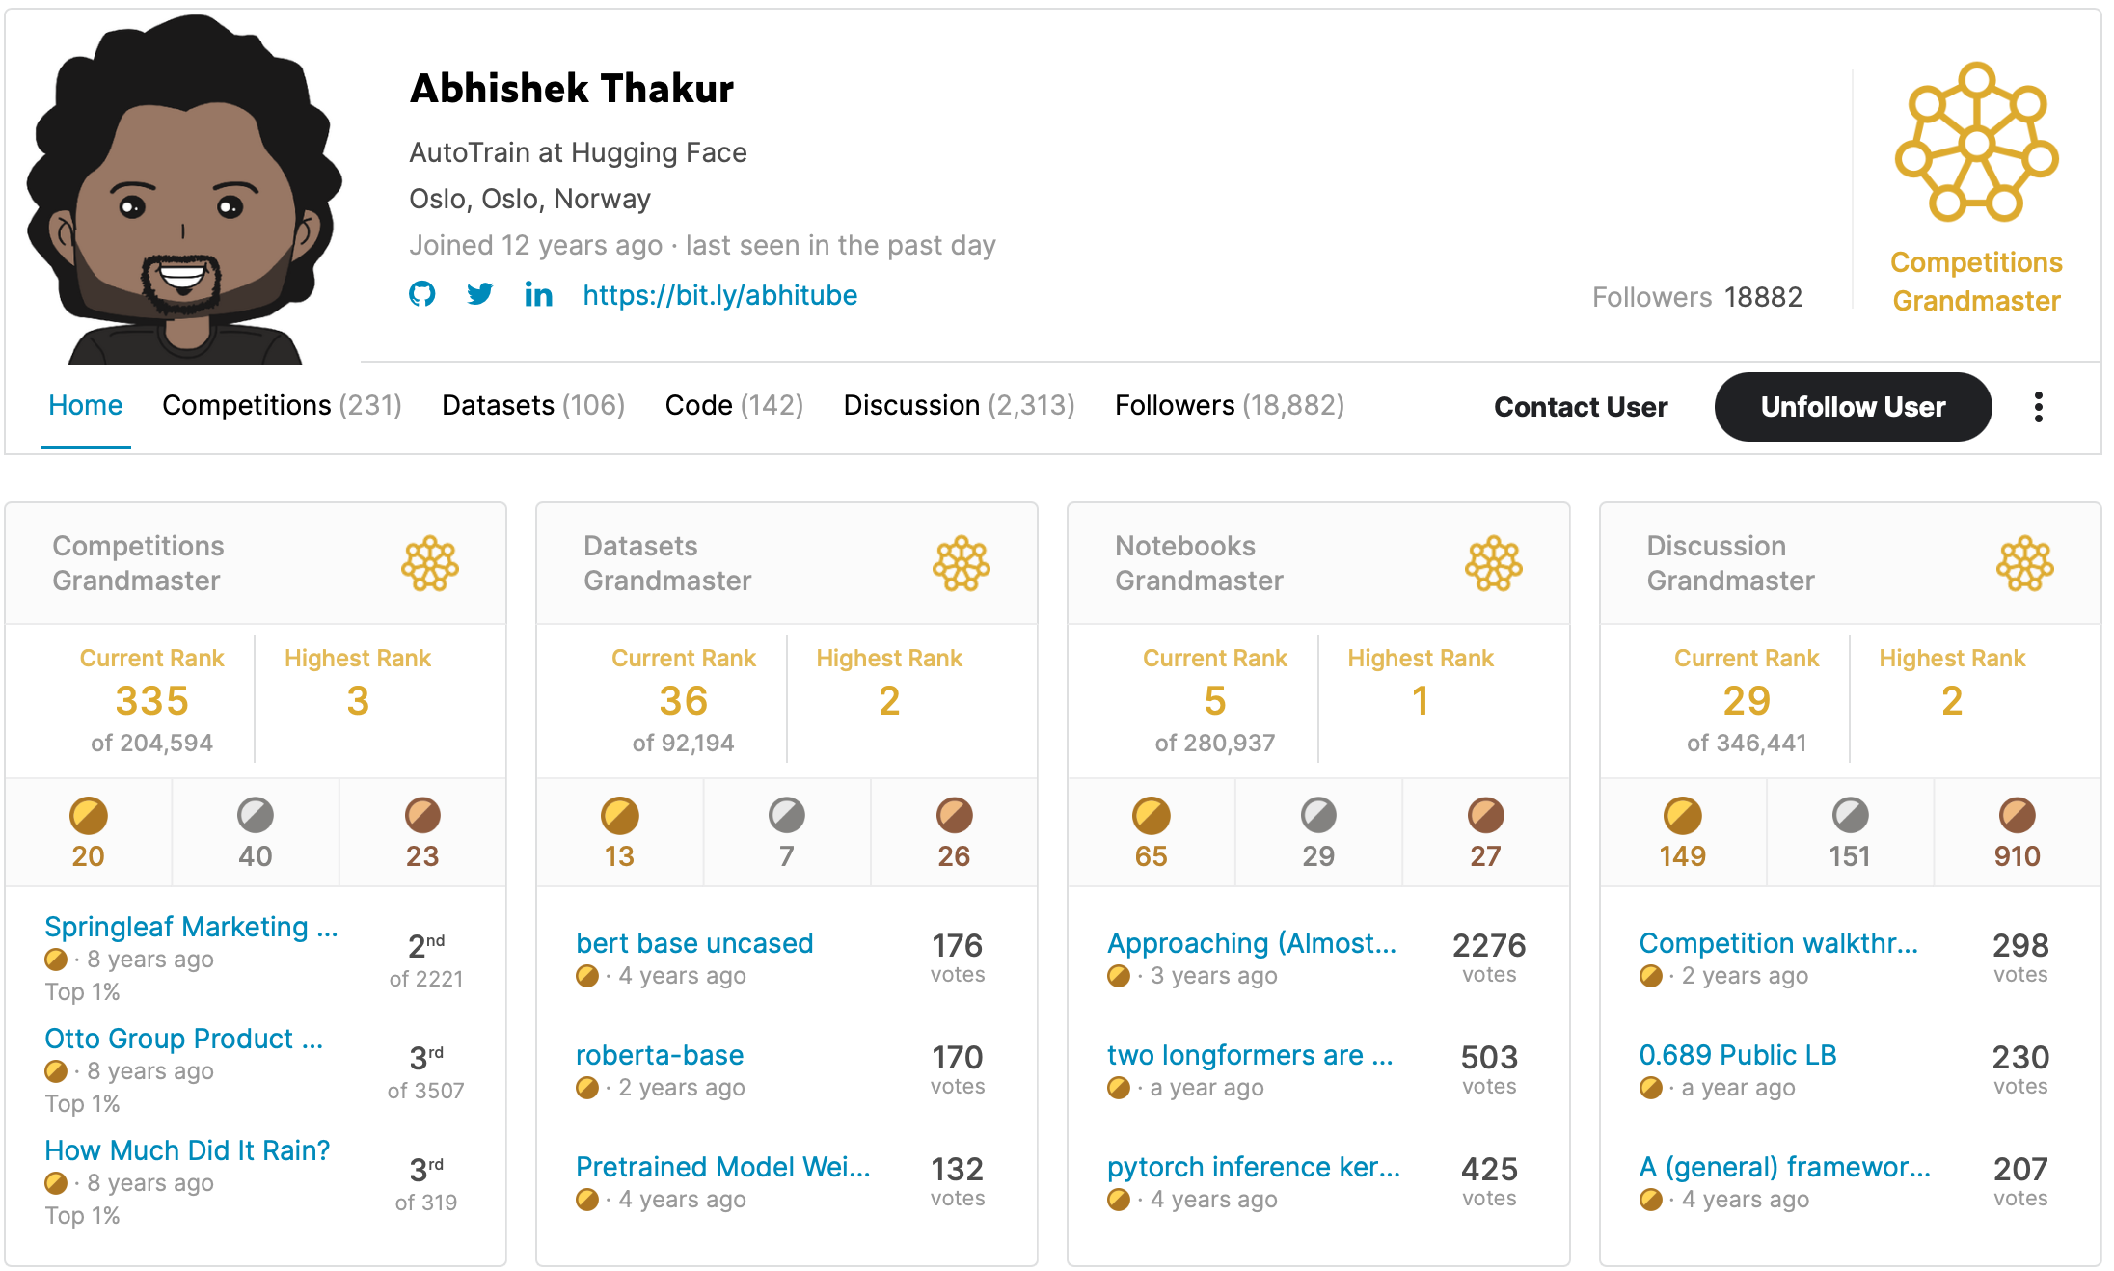
My Mentors
Abhishek Thakur
He did his B-Tech from NIT Surat in Electronics Engineering
He did his maters from The university of Bonn
He is currently working in the domain of Open Source Development & Research at hugging Faces
His github Profile is so dense that you can find numerous things to learn from Github Profile
Apart from this he is a 4x grandmaster in Kaggle Kaggle Profile

Slide 12
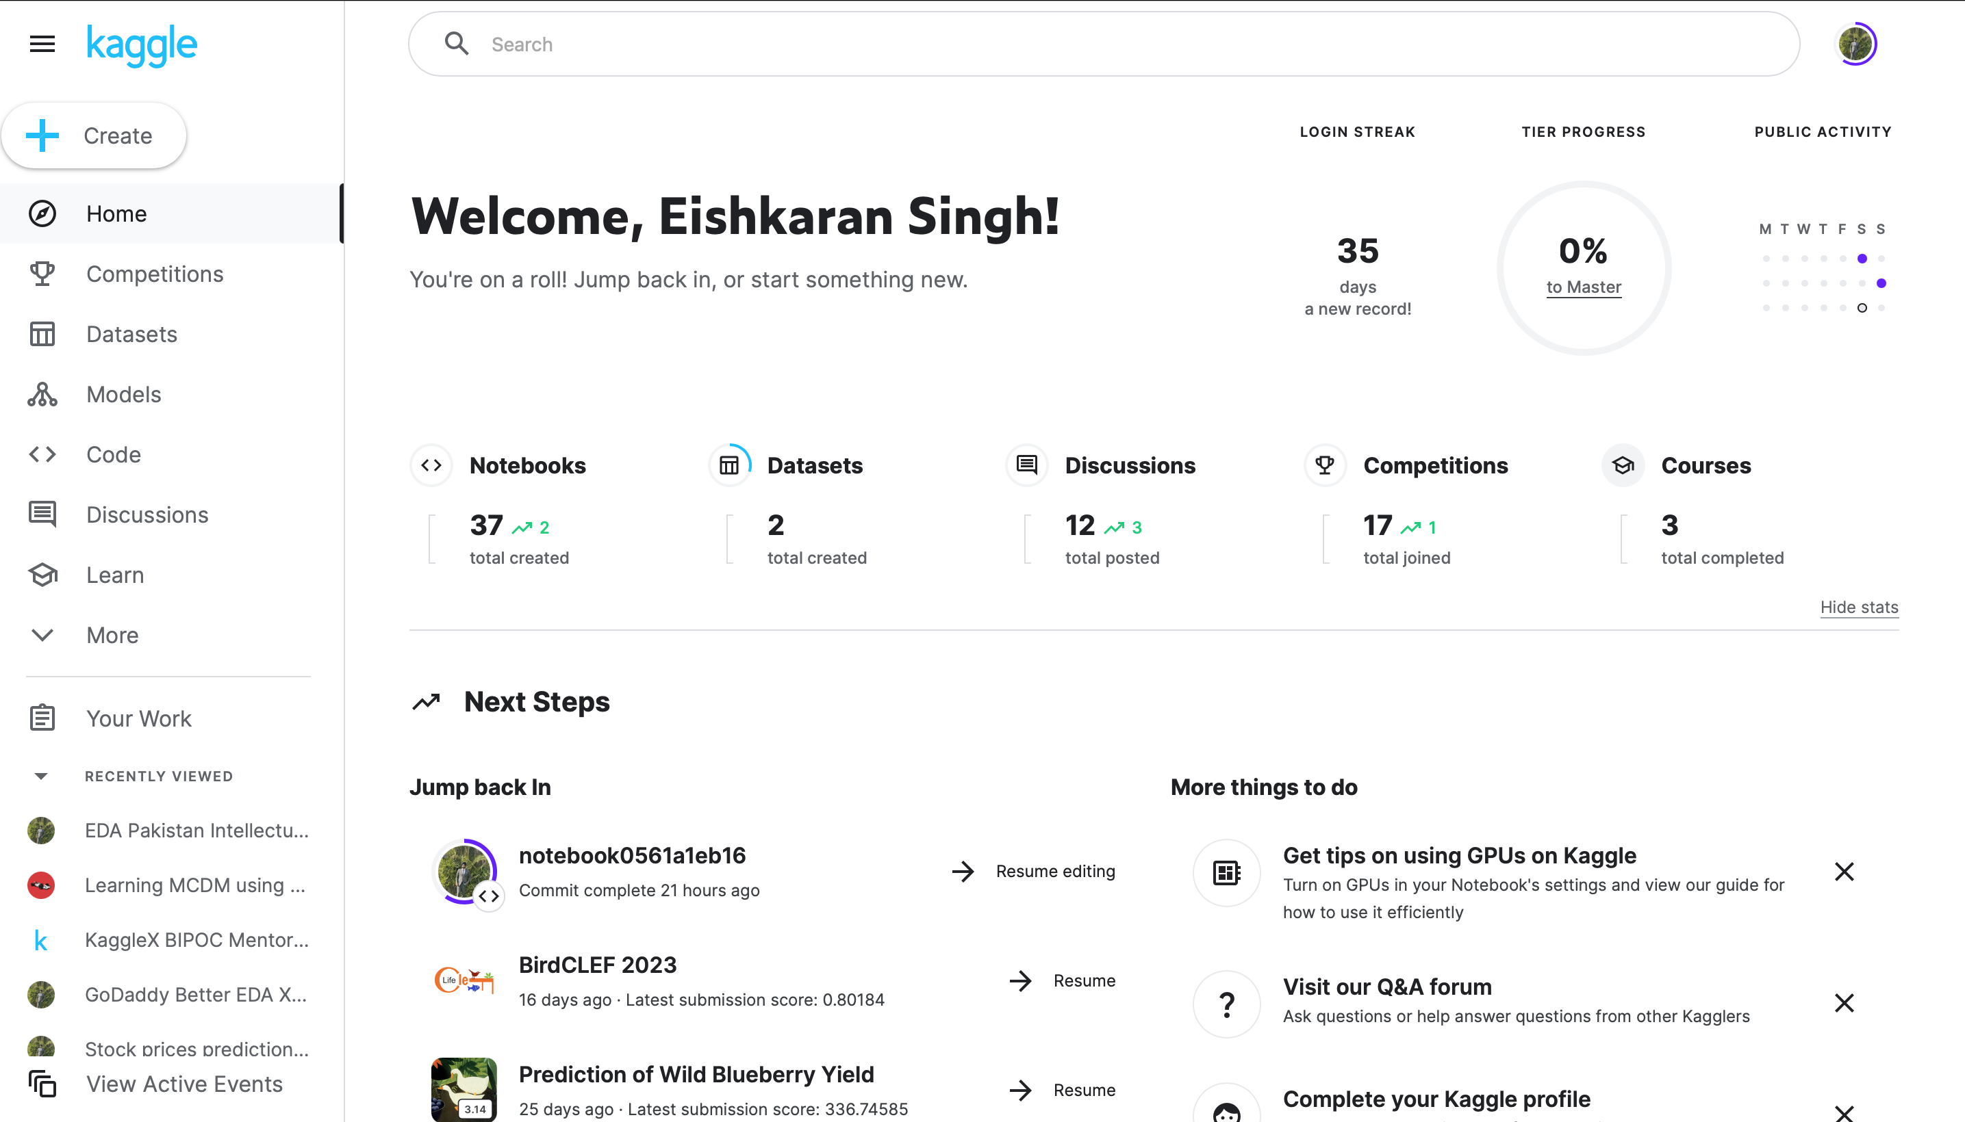
Kaggle
What to do in Kaggle and how to get Rankings ?
There are 4 Levels in Kaggle
Novice
Contributor
Expert
Master
Grandmaster

Slide 13
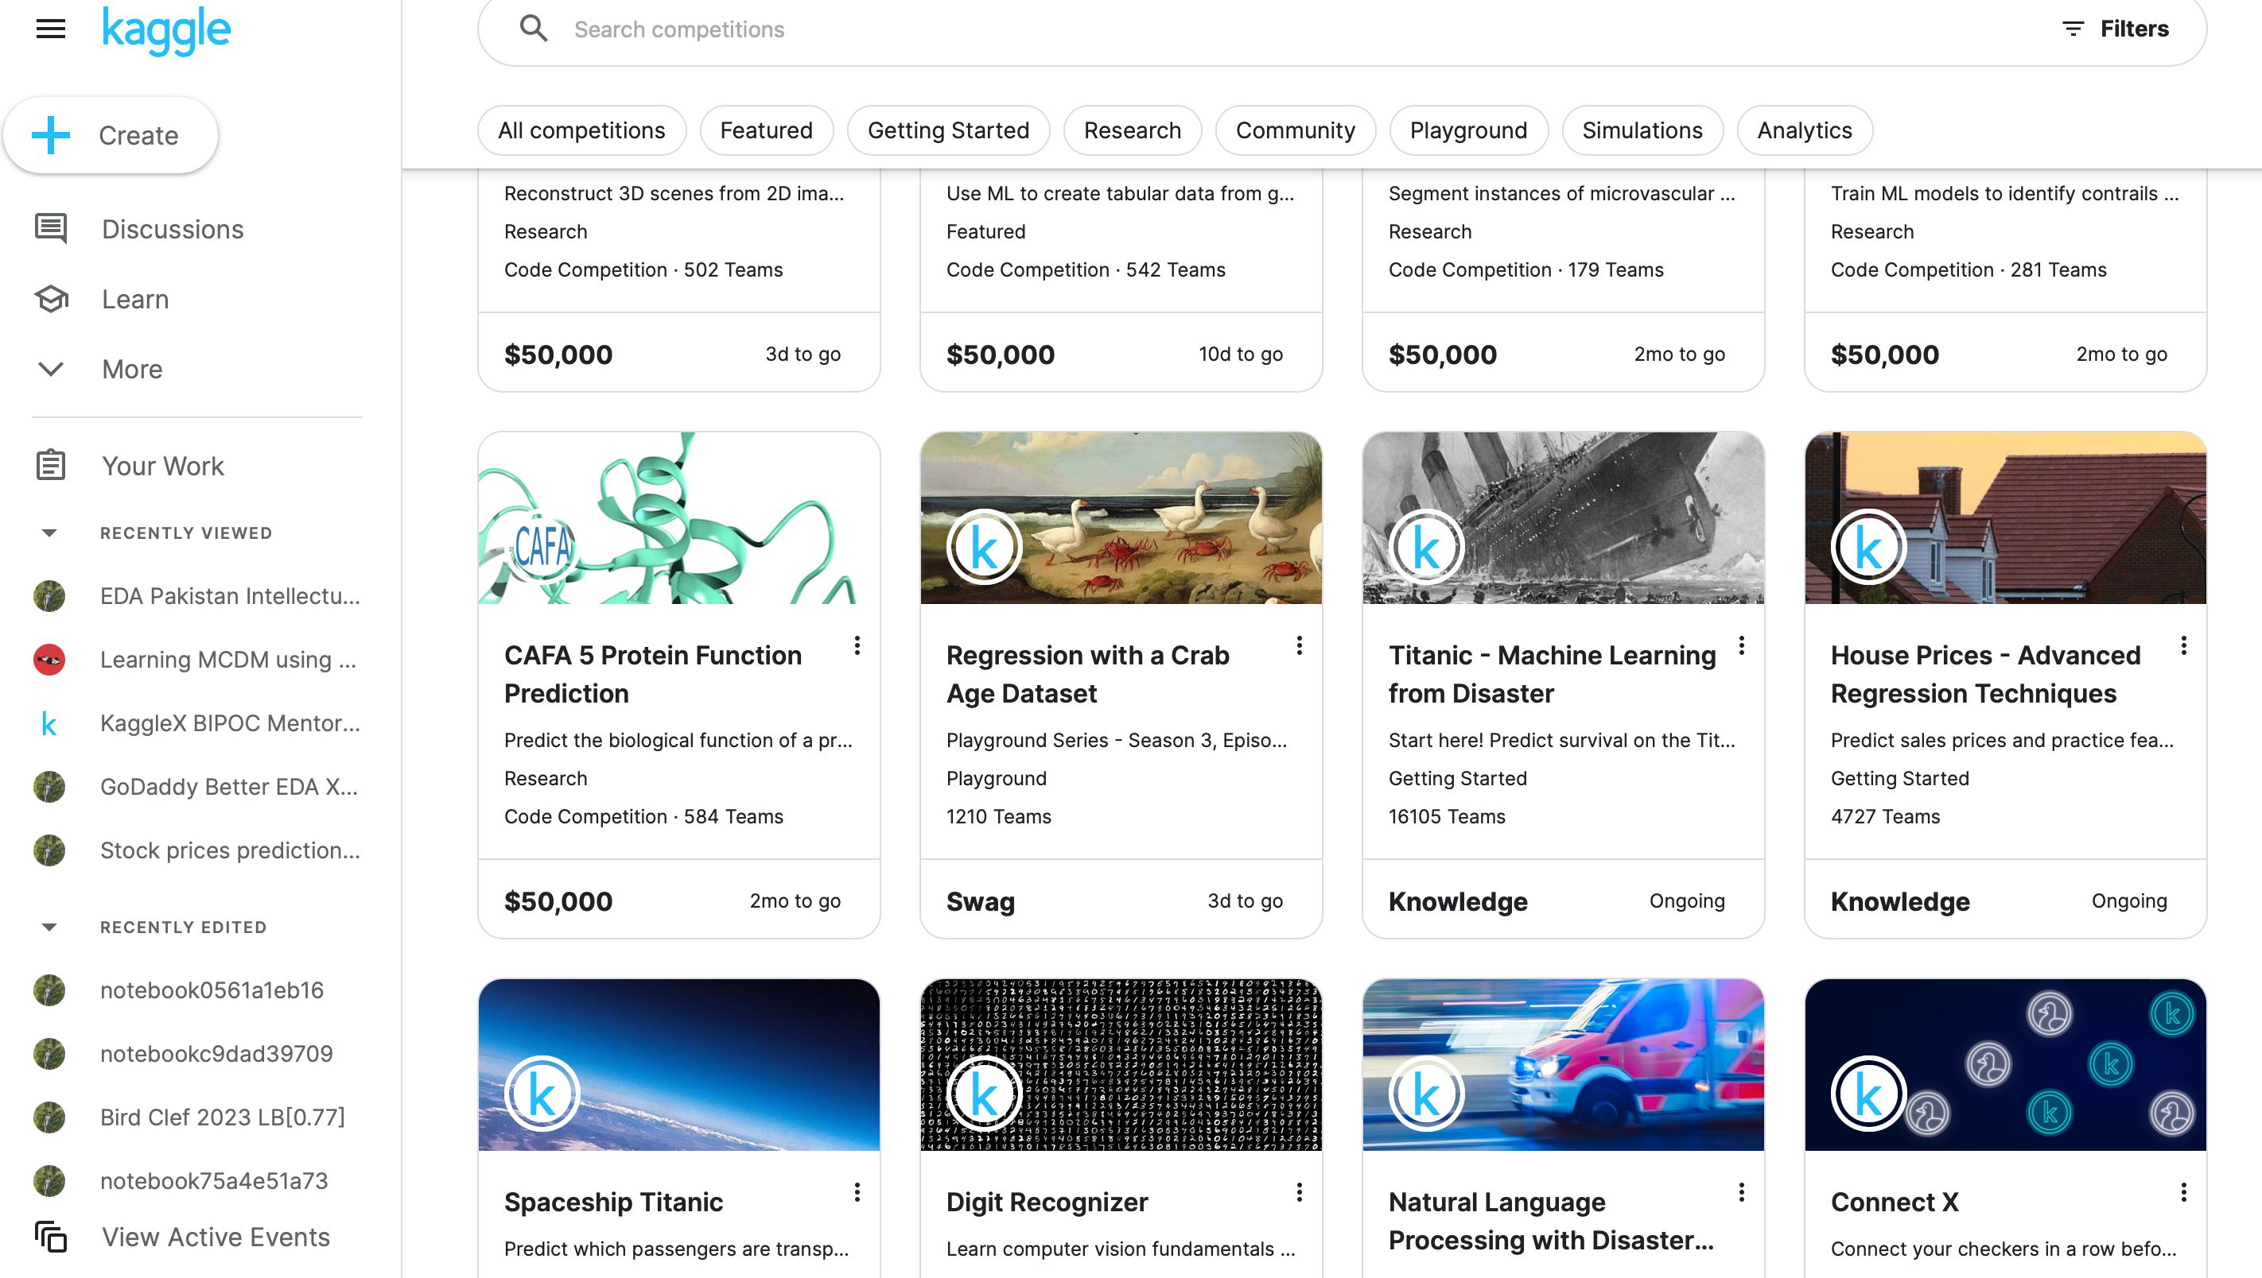
Kaggle
Competitions :-
Beginner Level :-
Titanic- Machine Learning from Disaster Competiton
House Prices-Advanced Regression techniques Competition
Spaceship Titanic Competition
Digit Recognizer Competition
Competitions :-
Advanced Level :-
Petals To Metals Competition
Natural Language Processing Disaster Competition
Store Sales Competition

Slide 14
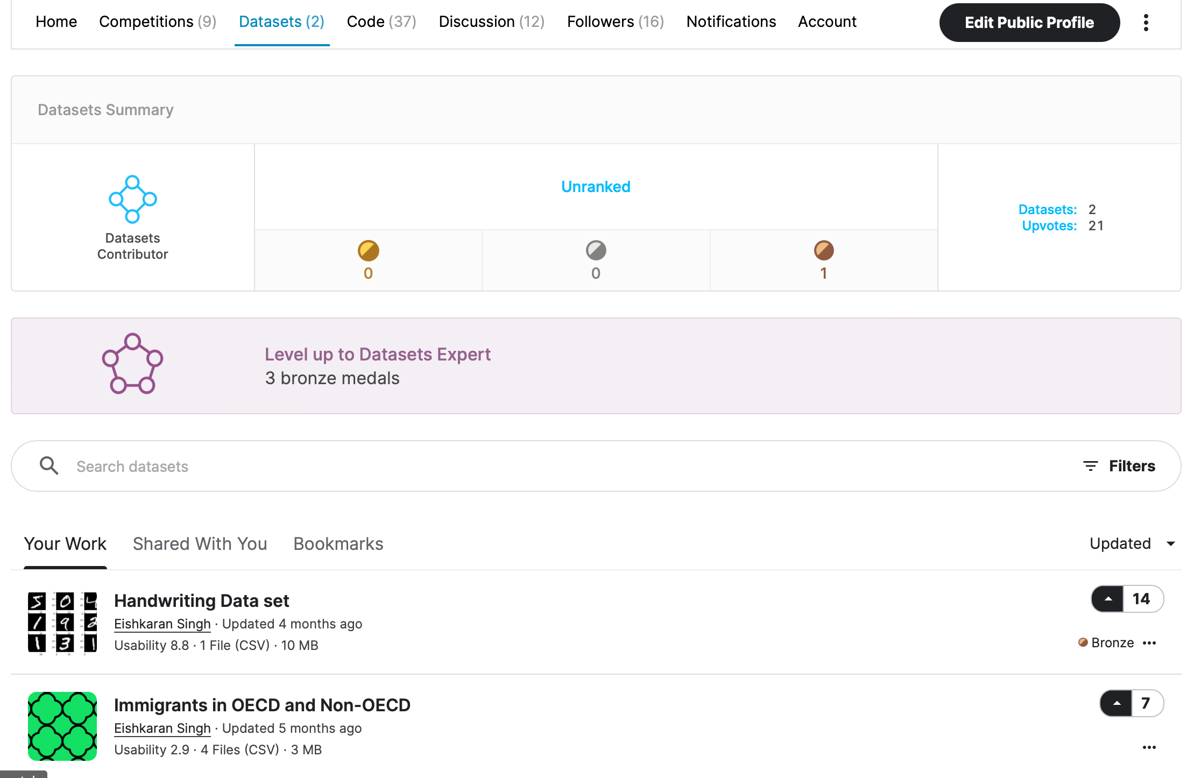
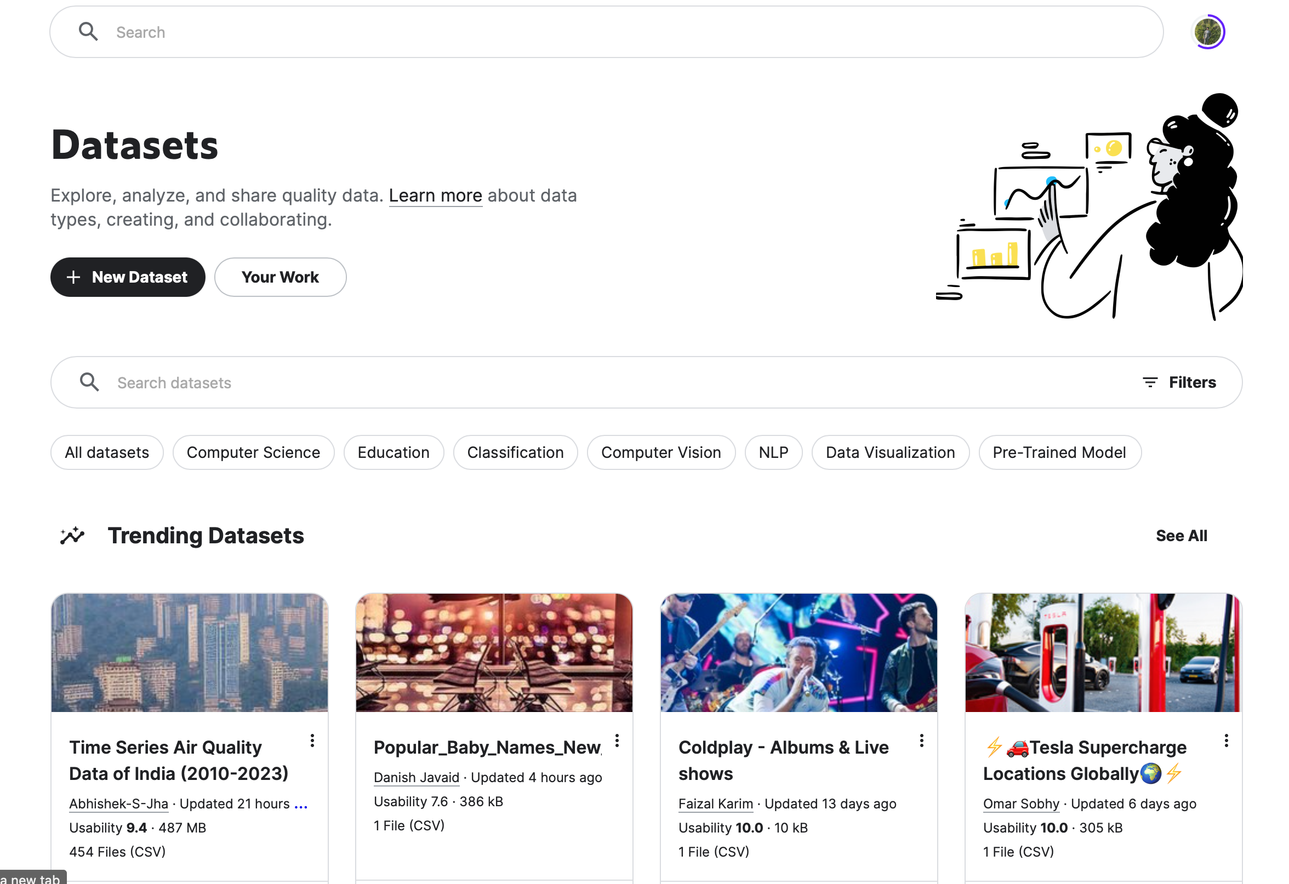
Kaggle
Datasets:- There are more than 50000 public datasets present in Kaggle but if you have something else to be processed except of those present you can add you dataset any time you want to.

Slide 15
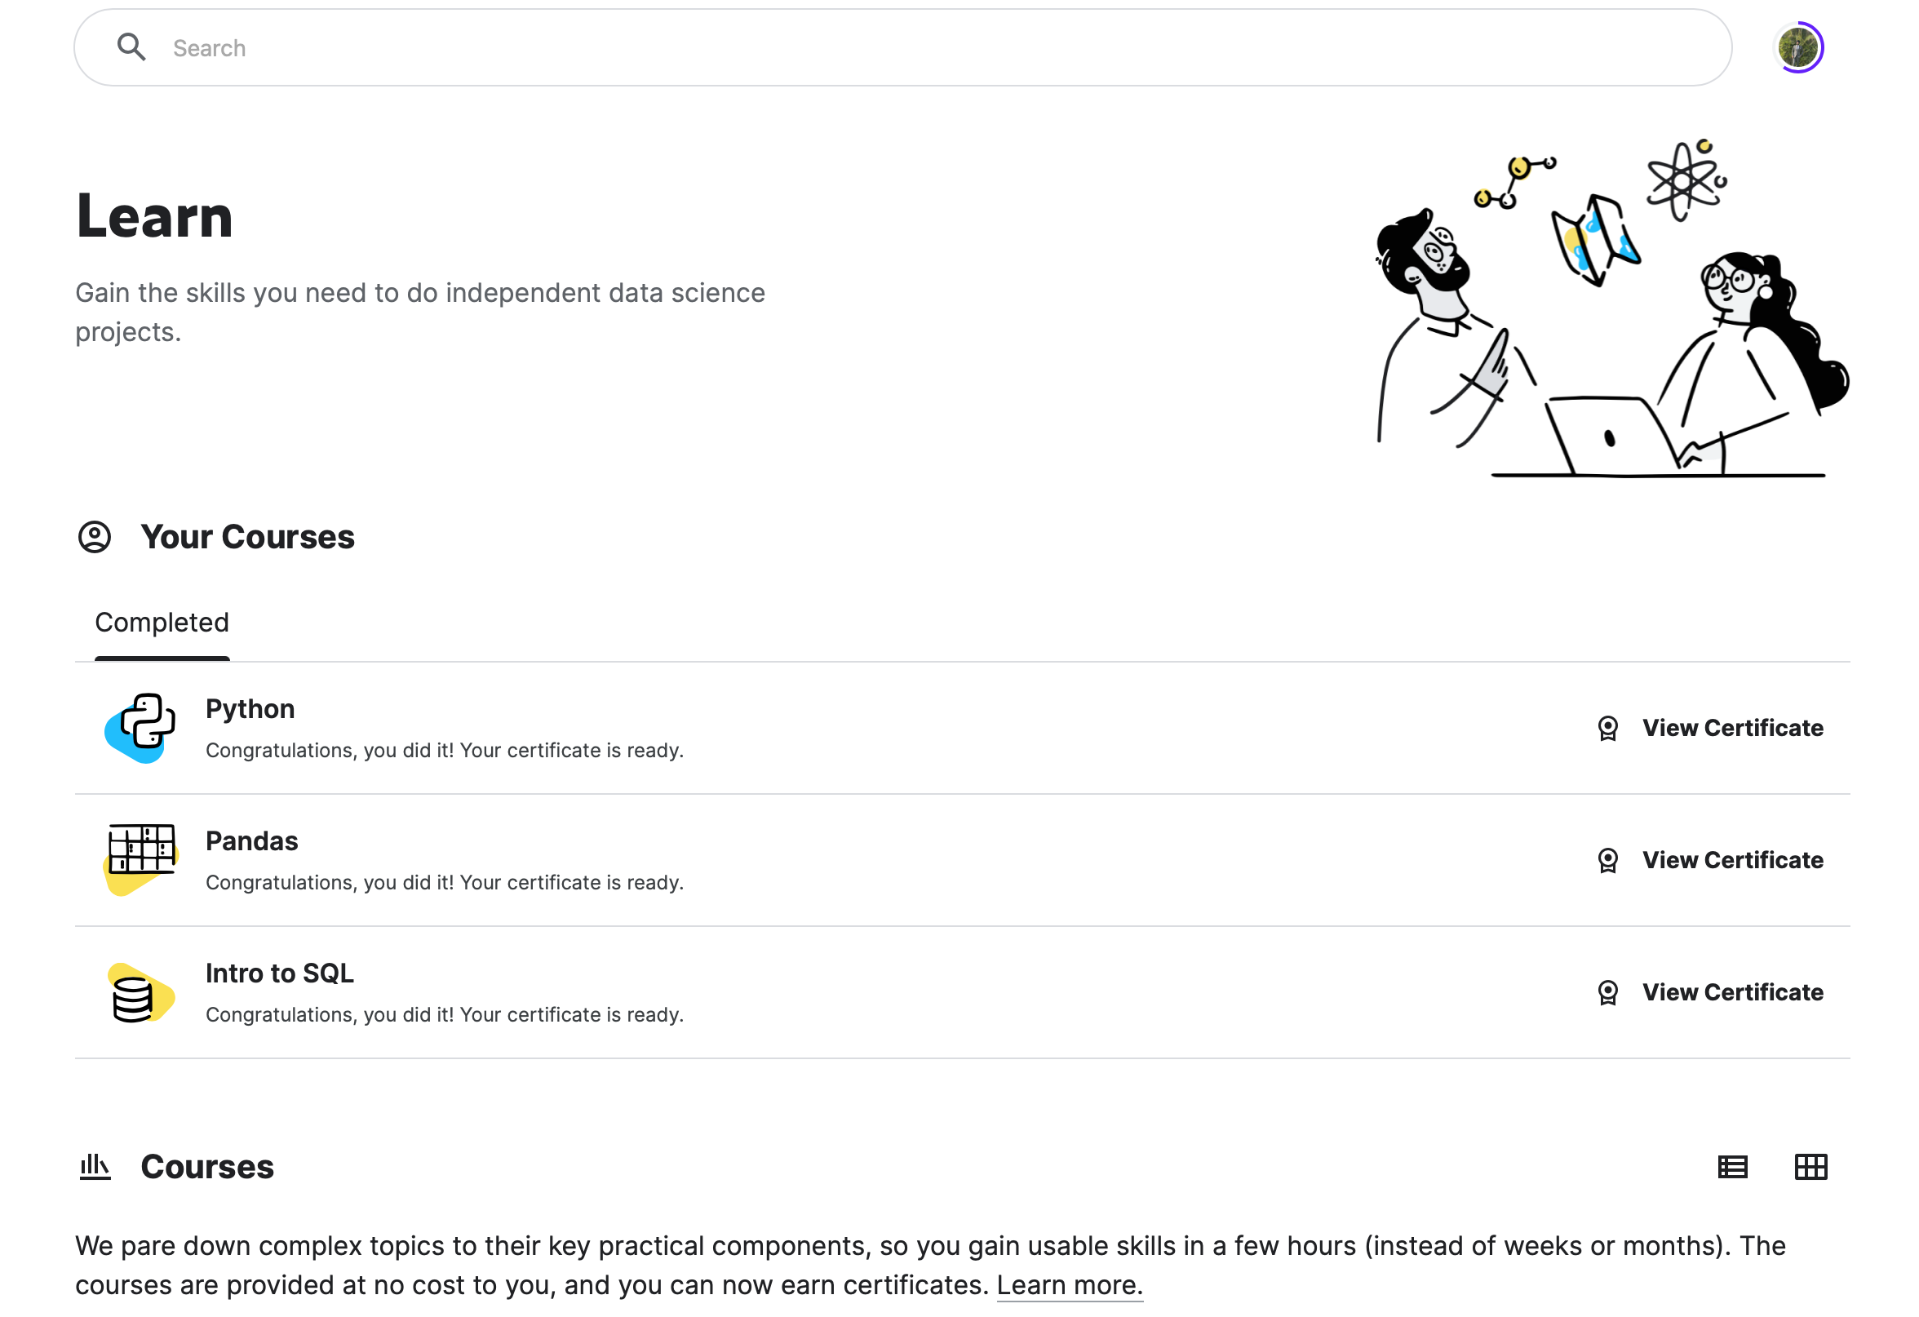
Kaggle
Learn:- There are many courses available in Kaggle you can go and learn from there and even get certifications

Slide 16
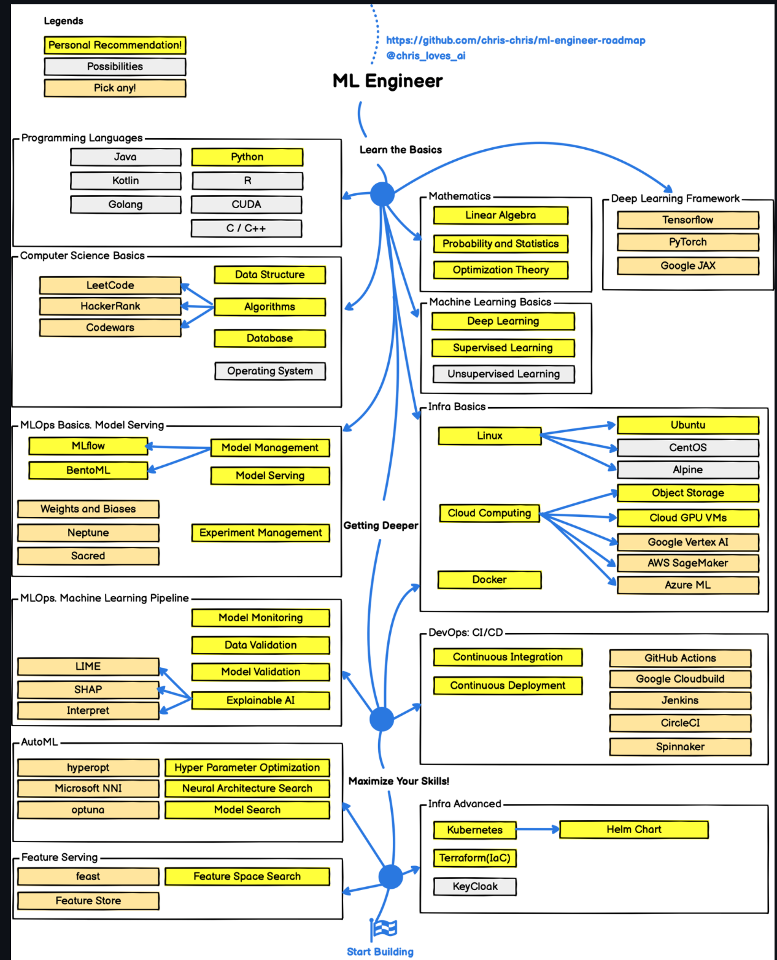
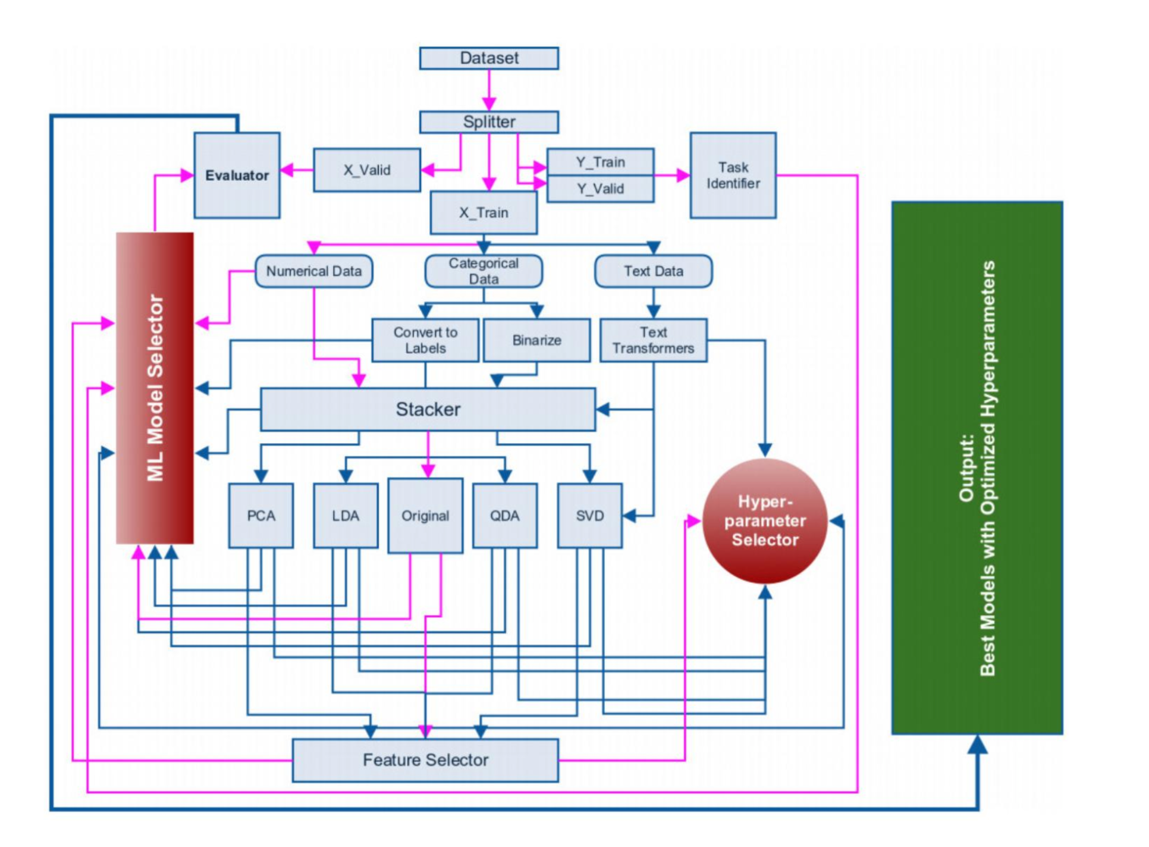
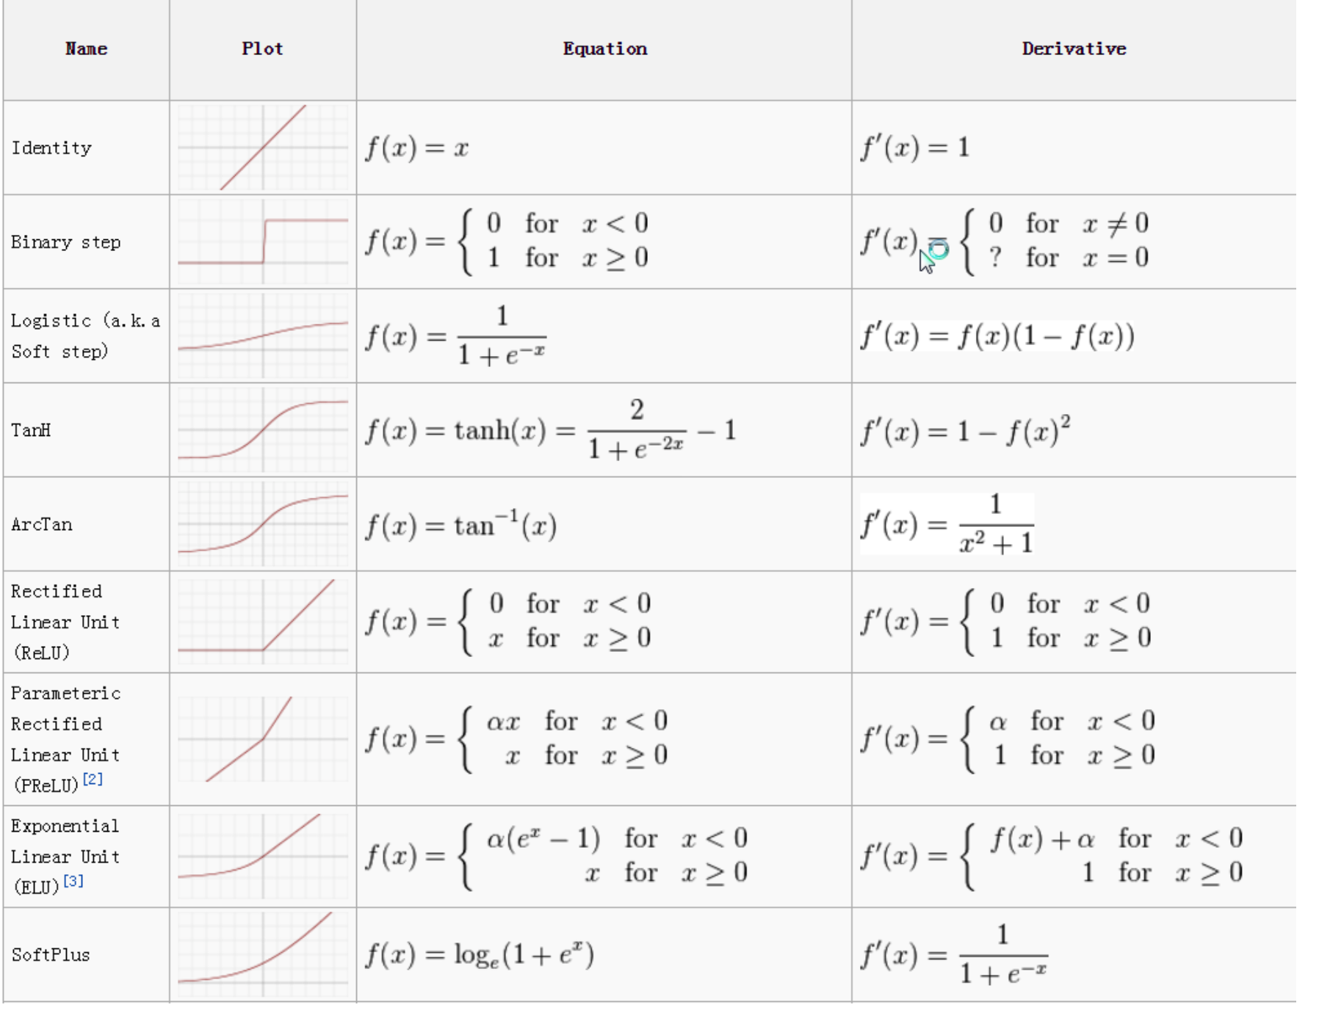
Some Important Points

Slide 17
Resources
Python
Code with Harry
HackerRank
Machine Learning
Couresera
Kaggle Machine Learning
Medium Blogs
Statistics
Medium Blog
Github repository
TSS-Resources
Data Visualization
Types of Visualisations
Sample Notebook 1
Sample Notebook 2
Sample Notebook 3
Data Visualisation Learn

Slide 18
Thank You

